Slide 1
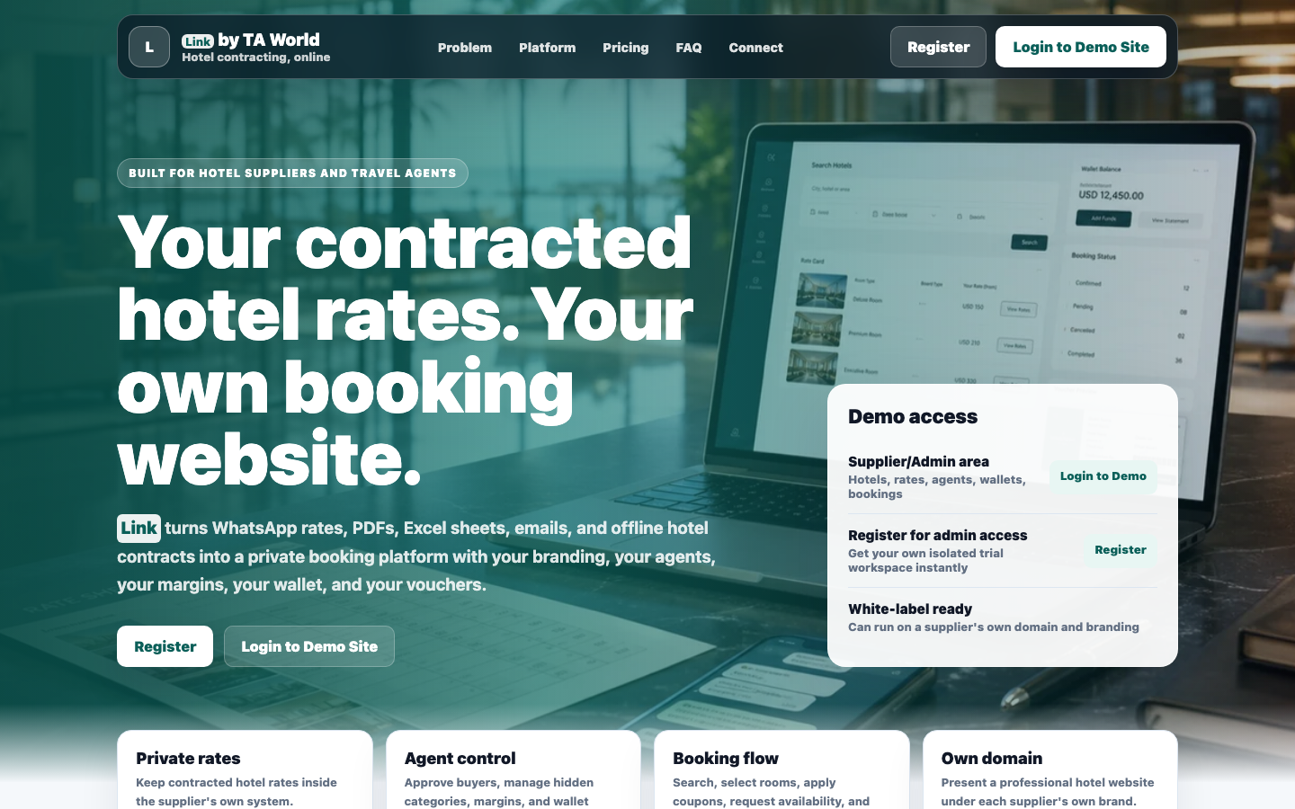
LINK BY TA WORLD
Your contracted hotel rates, now bookable online
For travel agents, DMCs, consolidators and wholesalers who want their own B2B + B2C hotel booking website with private rates, margins, inventory and vouchers.
Own domain
B2B + B2C
Private rates
Prepared for travel agent, DMC and consolidator conversations

Slide 2
THE REAL PROBLEM
Travel agents lose money because their rates are not searchable
Most agents have valuable contracts, but the rates live in WhatsApp chats, PDFs, emails, Excel files and memory. At query time, only a few hotels get remembered.
Rates are scattered
City coverage is unclear
Hotel contracts arrive as email, PDF, Excel, WhatsApp or verbal notes.
An agent may have 30 hotels in a city but remember only a handful during a query.
Sharing rates is sensitive
Bookings become manual
Agents need control over who sees what margin and who gets access.
Availability, payment, vouchers and cancellation follow-up happen outside one system.
Link by TA World
02

Slide 3
THE ANSWER
Link converts offline contracting into a sellable booking platform
The agent still owns the buyer relationship, the domain, the brand and the payment flow. Link gives the structure behind it.
One system for adding hotels, applying category-wise margins, selling rooms, collecting wallet payments and issuing vouchers.
1
2
3
4
5
Hotel master on you own URL
Room + rates
Margins
Buyer search
Voucher + reports
Link by TA World
03

Slide 4
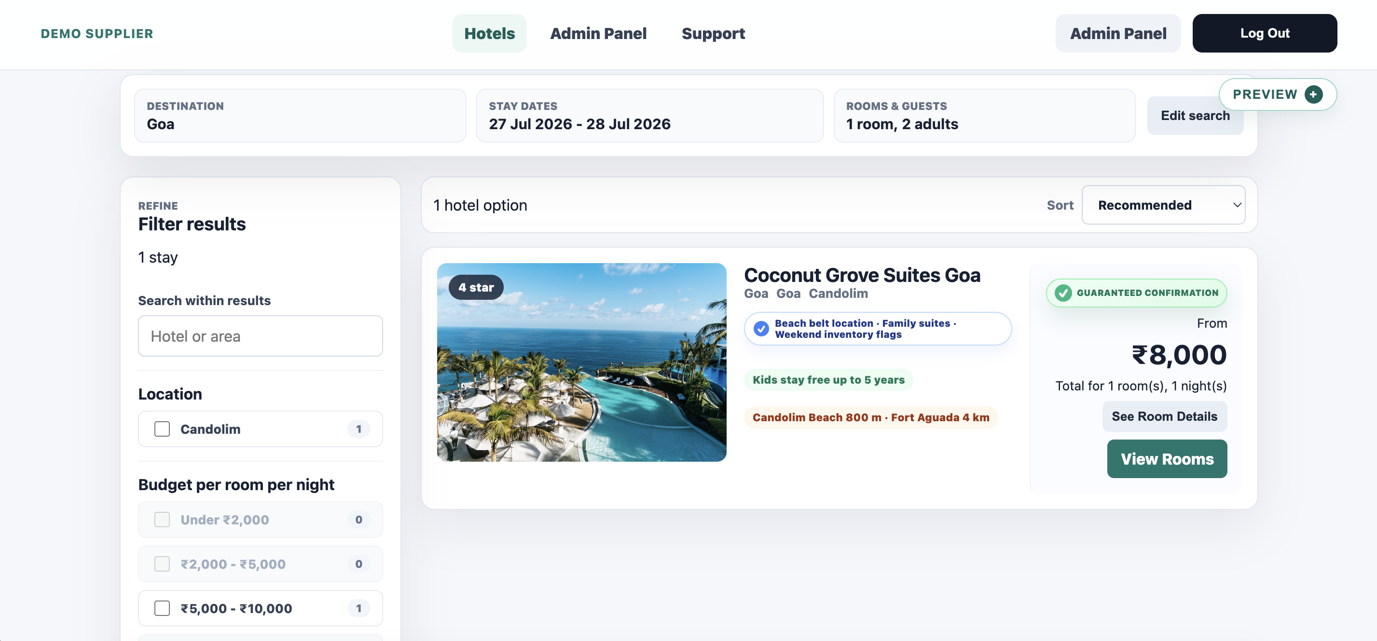
BUYER EXPERIENCE
Your buyers see a proper hotel booking website, not an Excel sheet
A travel agent can offer a polished search, room selection and booking flow while keeping the backend rate logic private.
Modern hotel display
Room images, meal plans, inclusions, inventory and date-wise rates are shown clearly.
Private pricing engine
The buyer never sees your net rate or category logic.
Booking-ready flow
Lead guest, cancellation policy, payment deadlines and vouchers stay connected.
Link by TA World
04

Slide 5
TWO SALES CHANNELS
The same website can sell to agents and direct customers
Agents can run a wholesale B2B portal, a direct customer booking site, or both from the same backend.
B2B agents
B2C customers
Admin control
Other travel agents can register, get approved, and see sell rates based on their hidden category.
Direct customers can search hotels, request bookings and receive vouchers under your brand.
You decide which hotels are live, which rates apply and who can access what.
CAT A, CAT B and CAT C pricing remains private. Buyers only see the final sell rate.
Link by TA World
05

Slide 6
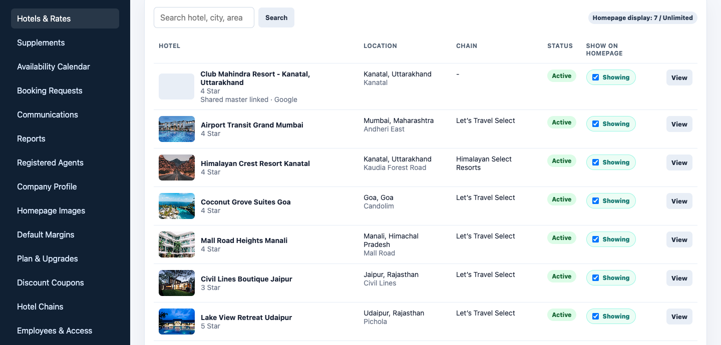
HOTELS AND RATES
Your team can organize contracted hotels properly
Instead of one spreadsheet, each hotel has its own details, room categories, meal charges, rate ranges, taxes, inventory and cancellation policy.
Google hotel master
Add a hotel faster using Google data, then manage your private details separately.
Room-wise rates
Upload rates against room categories with date ranges and inventory.
Show on website
Only selected hotels are visible as per the plan and admin choice.
Link by TA World
06

Slide 7
RATE ENGINE
Built for real contracting, not flat hotel listings
The system separates the things that agents actually negotiate: base rates, meals, taxes, extra guests, supplements, stop-sale and inventory.
Date-wise rates
Weekdays, weekends, seasons and multiple date ranges can be uploaded cleanly.
Meal upgrades
CPAI, MAPAI and APAI pricing can calculate from hotel-level meal charges.
Extra guest logic
Adult and child charges can be fixed or percentage-based with markup controls.
Supplements
Long weekend, festival and blackout-date charges can be added separately.
Inventory
Guaranteed confirmation appears only when loaded inventory covers the request.
Link by TA World
07

Slide 8
MARGINS WITHOUT EXPOSING SECRETS
Different buyers can see different sell rates without knowing why
This is important for wholesalers and consolidators who want to reward stronger agents without telling everyone their category.
CAT A
CAT B
CAT C
B2C
Lowest margin for high-potential agents
Middle margin for regular agents
Standard margin for normal agents
Customer rate controlled separately
The category is never shown to the buyer. It stays only in admin records.
Link by TA World
08

Slide 9
BOOKING OPERATIONS
Bookings move through a controlled workflow
Availability requests, guaranteed inventory, wallet payments, reminders, vouchers and cancellations are handled inside one system.
1
2
3
4
5
Search
Select
Request/confirm
Pay
Voucher
Buyer searches city, dates and room-wise occupancy.
Room, meal plan, inclusions and cancellation terms are reviewed.
On-request booking goes to supplier; inventory booking asks for payment.
Wallet debit, payment deadline and reminders keep action visible.
Confirmation voucher is issued under buyer/company branding.
Link by TA World
09

Slide 10
SELLING TOOLS
Agents can promote hotels instead of only forwarding rates
Link gives the agent tools to turn contracts into campaigns and repeatable sales.
Offers and packages
Discount coupons
Homepage sliders
Book 3 nights, get last night complimentary; minimum-stay benefits; room-only or meal-plan based offers.
Hotel-wise, chain-wise, selected user or email, percentage cap or fixed amount discounts.
Promote preferred hotels, special deals or paid partner placements on the website homepage. You can even charge a fee from Hotels for this space.
This helps an agent sell inventory and contracted rates, not just store them.
Link by TA World
10

Slide 11
TEAM CONTROL
The owner can give employees only the access they need
Reservations, accounts and rate-loading teams can work inside the same system without exposing every control to everyone.
Reservations
Accounts
Bookings, availability requests, confirmation numbers and vouchers.
Wallet top-ups, payment history, booking payments and reports.
Rate loading
Support
Hotels, rooms, date-wise rates, supplements and stop-sale.
Buyer communication, live chat and broadcast messages.
Link by TA World
11

Slide 12
WHO SHOULD USE IT
Link fits agents who already have hotel buying power
It is strongest when the agent has contracted rates, pre-purchased inventory, a network of sub-agents, or a destination/product focus.
Business type | Primary use | Best plan direction
Small travel agent | Organize contracted rates and search faster | Starter
DMC / destination specialist | Sell selected hotels to agents and direct clients | The Best
Hotel consolidator | Approve agents, manage margins and distribute many hotels | The Best+
Large wholesaler | Unlimited hotel selling, custom reports and heavier operations | Premium Managed
Link by TA World
12

Slide 13
PRICING
Plans scale from rate organisation to full distribution
The same platform can start as a serious rate library and grow into a complete B2B/B2C hotel selling engine.
PLAN
RECOMMENDED
PLAN
PLAN
Starter
The Best
The Best+
Premium Managed
₹19,999
₹29,999
₹89,999
₹149,999
₹9,999
₹19,999
₹74,999
₹125,000
one-time setup + GST
one-time setup + GST
one-time setup + GST
one-time setup + GST
₹999/month
₹9,999/year
₹999/month
₹9,999/year
₹4,999/month
₹49,999/year
₹9,999/month
₹99,999/year
hosting/support + GST
hosting/support + GST
hosting/support + GST
hosting/support + GST
Best for agents who want to organise contracted hotel rates professionally.
For agents who want B2B/B2C booking and can sell up to 50 hotels.
For agents who want to sell unlimited hotels to agents and direct clients.
Priority support, customisation, reports, voucher formats and heavy workflows.
Link by TA World
13

Slide 14
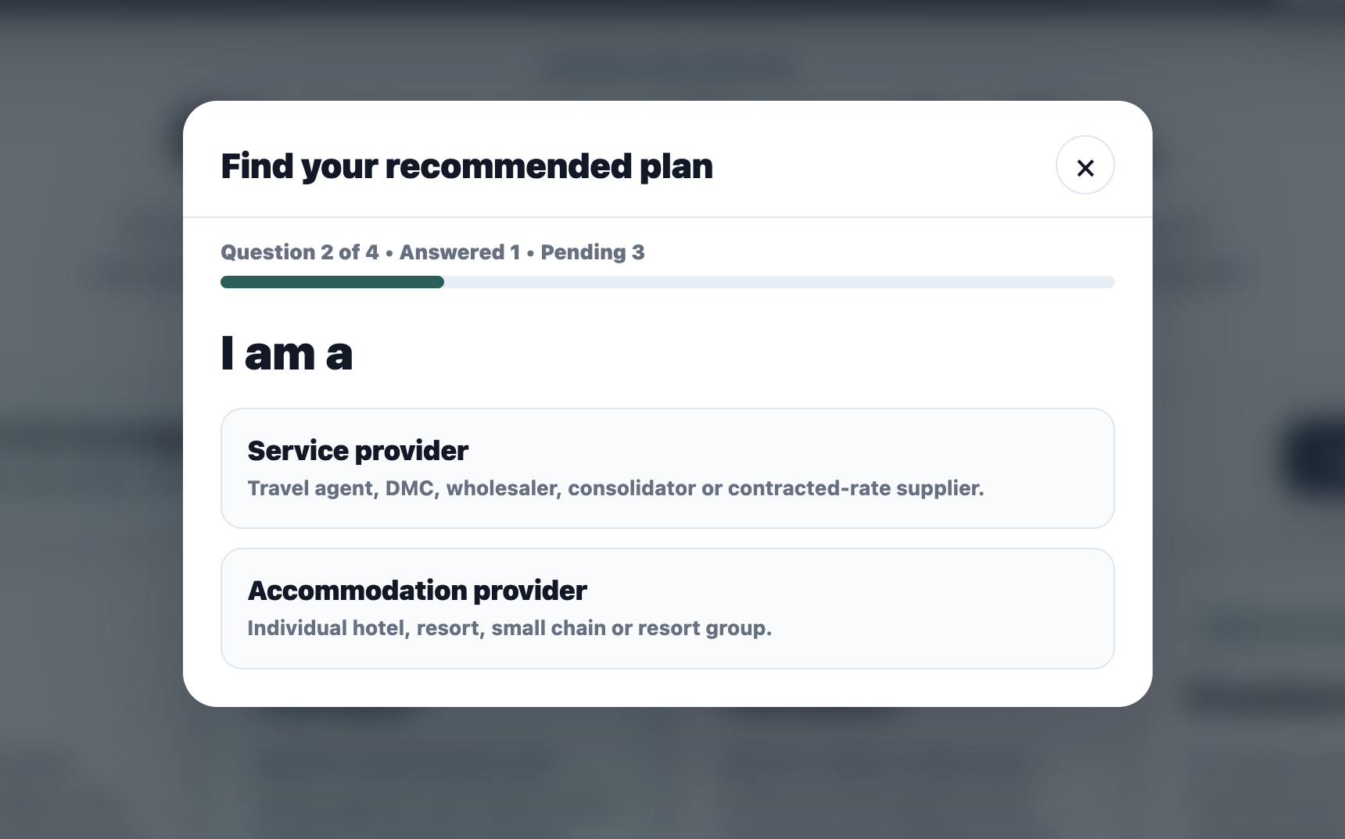
PLAN ADVISOR
A guided flow can recommend the right package
A few simple questions decide whether the agent needs only organisation, limited selling, unlimited distribution, or premium managed support.
1
Hosting managed by Link or self-hosted
2
Service provider or accommodation provider
3
Whether hotels will also be sold online
4
Recommended plan highlighted automatically
Link by TA World
14

Slide 15
SEE IT LIVE
Stop searching old files. Start selling your rates.
Register on Link to get demo admin access, test the booking flow, and discuss the right setup for your own branded B2B + B2C hotel booking website.
Website
Demo admin access
Contact
Vipul Tripathi
+91 99586 30101
https://link.taworld.co.in
https://link.taworld.co.in/supplier/register

