Slide 1
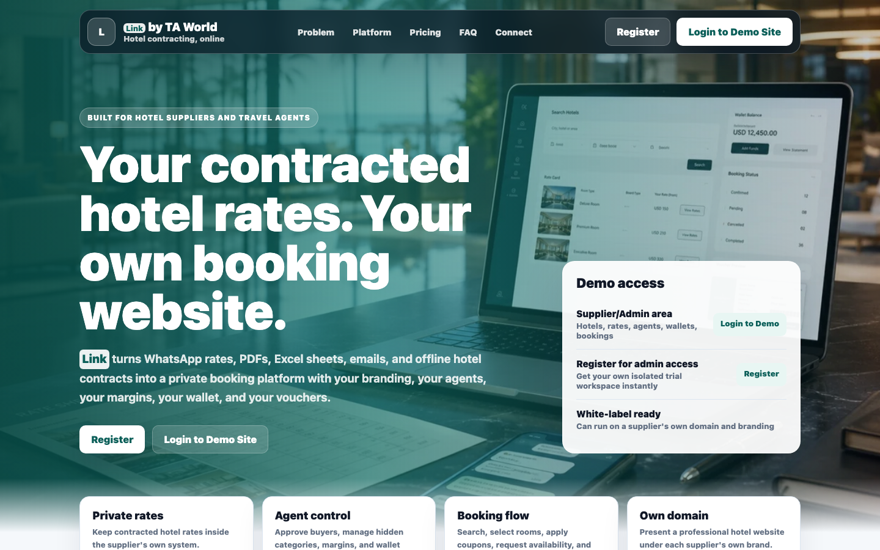
LINK BY TA WORLD
Launch your own bookable hotel website
For standalone hotels, resorts and hotel chains that want direct customer bookings, controlled agent distribution, rates, inventory, vouchers and communication under their own brand.
Own domain
B2B + B2C
Inventory + on-request
Prepared for hotel and chain conversations

Slide 2
THE OFFLINE GAP
Most hotel sales still run on memory, WhatsApp and manual follow-up
The problem is not only getting bookings. It is controlling who sees what rate, which dates are available, and what happens after a booking request arrives.
Rates are scattered
Agents need different pricing
PDFs, Excel files, email contracts and WhatsApp messages become hard to search.
High-potential agents, normal agents and direct customers should not see the same rate.
Inventory needs trust
Follow-up is expensive
Pre-purchased rooms must show guaranteed confirmation only when enough rooms exist.
Availability checks, payment deadlines, vouchers and cancellations need reminders and audit trails.
Link by TA World
02

Slide 3
THE PLATFORM
Link turns hotel contracting into a controlled booking system
The same system can run as a single-hotel website, a small-chain booking site, or a larger hotel distribution portal.
One admin controls hotel data, rooms, rate logic, agent approvals, customer bookings, payments, notifications and vouchers.
1
2
3
4
5
Google hotel master
Room categories
Rates + inventory
Buyer booking flow
Voucher + reports
Link by TA World
03

Slide 4
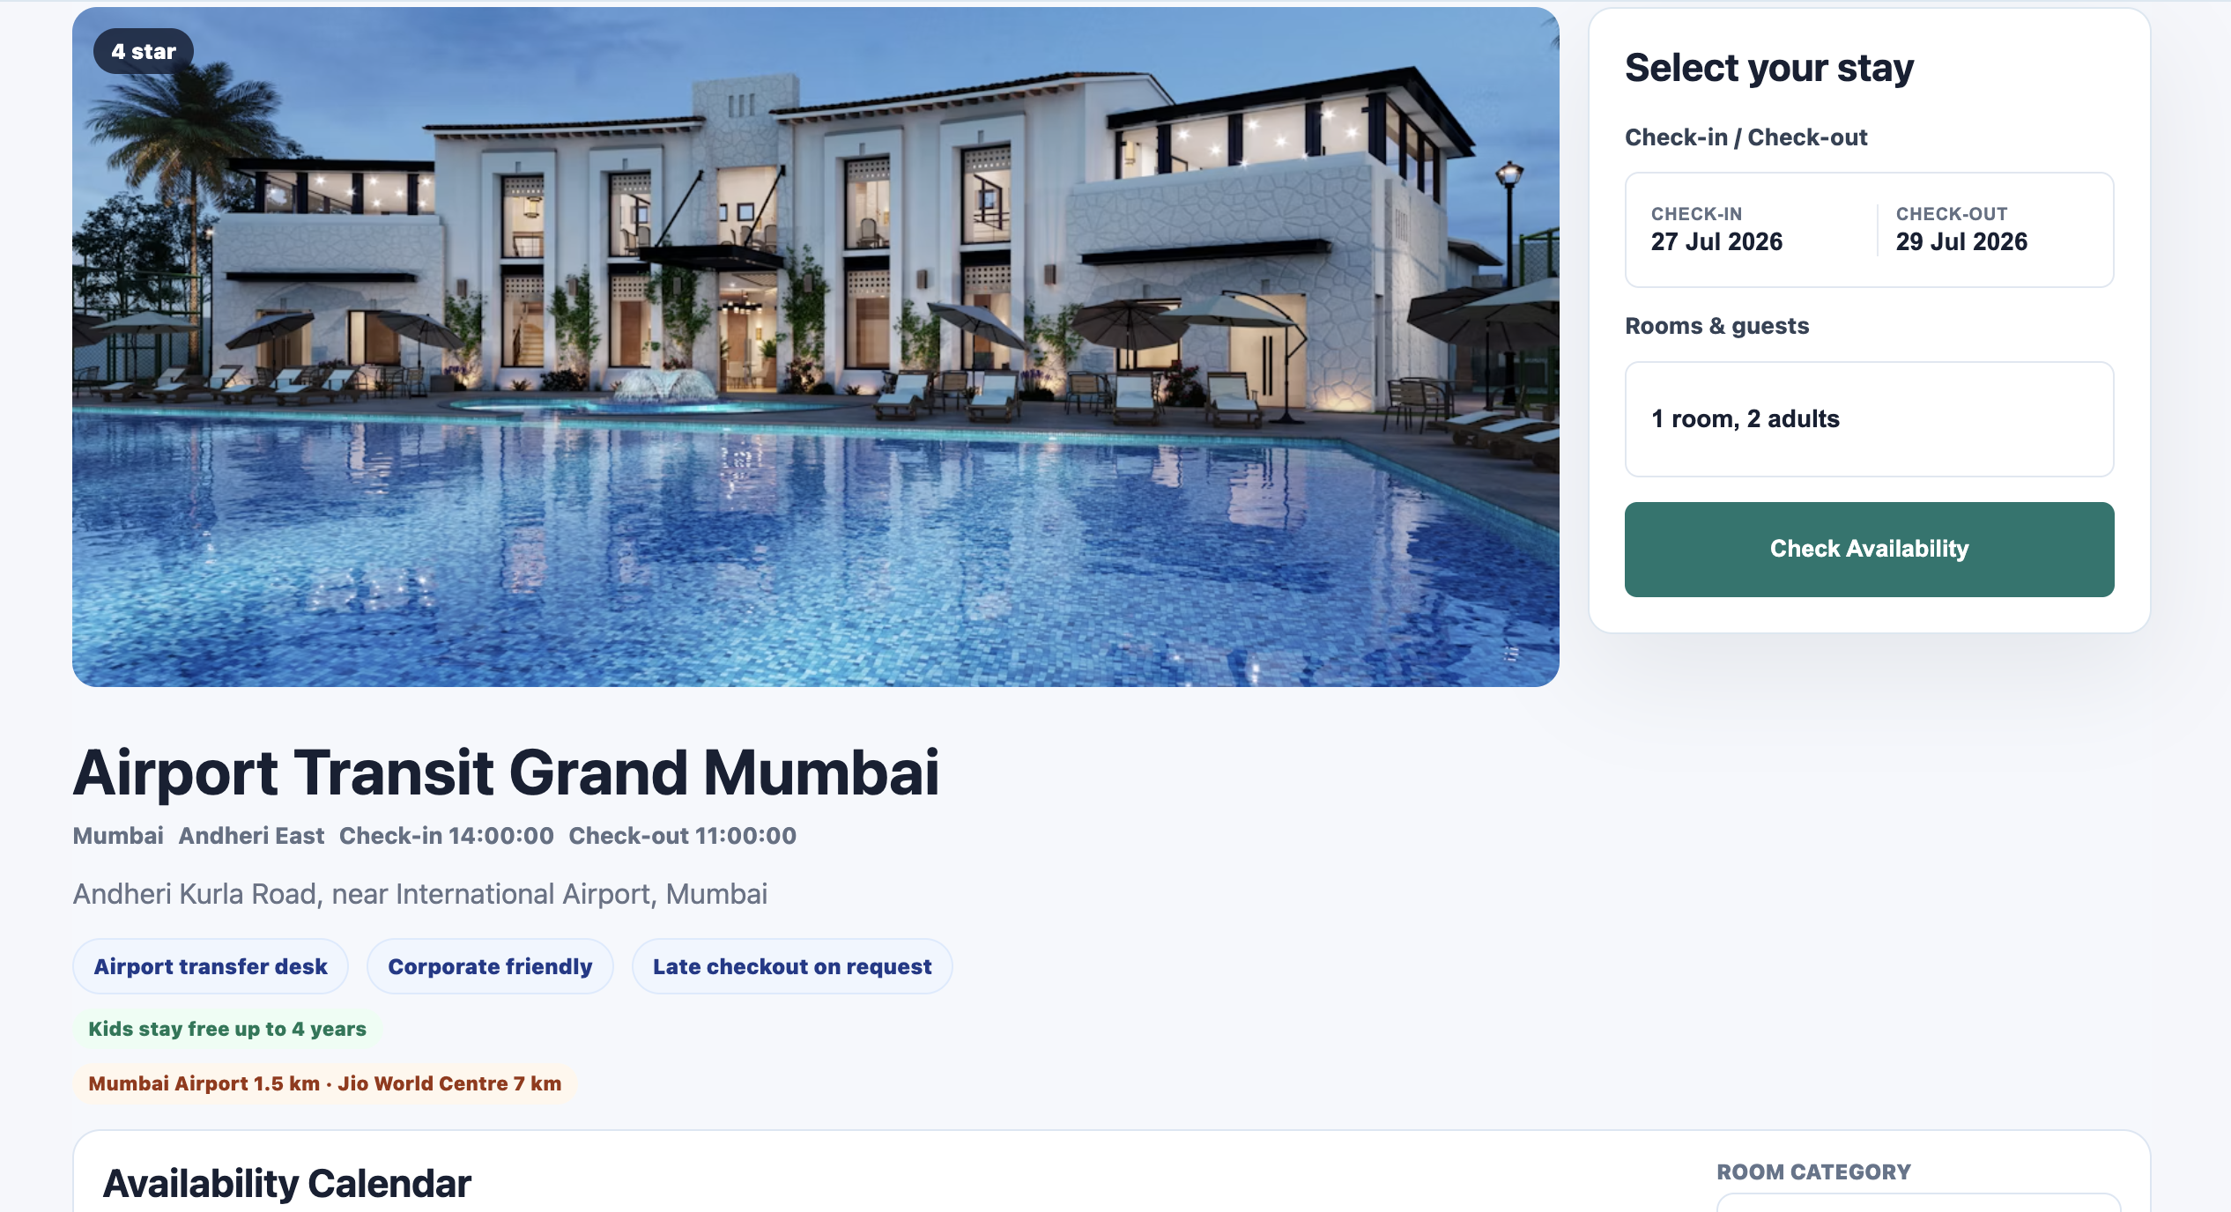
CUSTOMER EXPERIENCE
A single hotel can get a professional direct booking page
Direct website
Login and registration stay available, but customers can start from the hotel page.
The public page focuses on the hotel, stay dates, room choices, inclusions, cancellation terms and booking request flow.
Bookable rooms
Each room can show meal plans, date-wise rates, inventory status and inclusions.
Mobile-first
Built to work like an app through browser install and push notifications.
Link by TA World
04

Slide 5
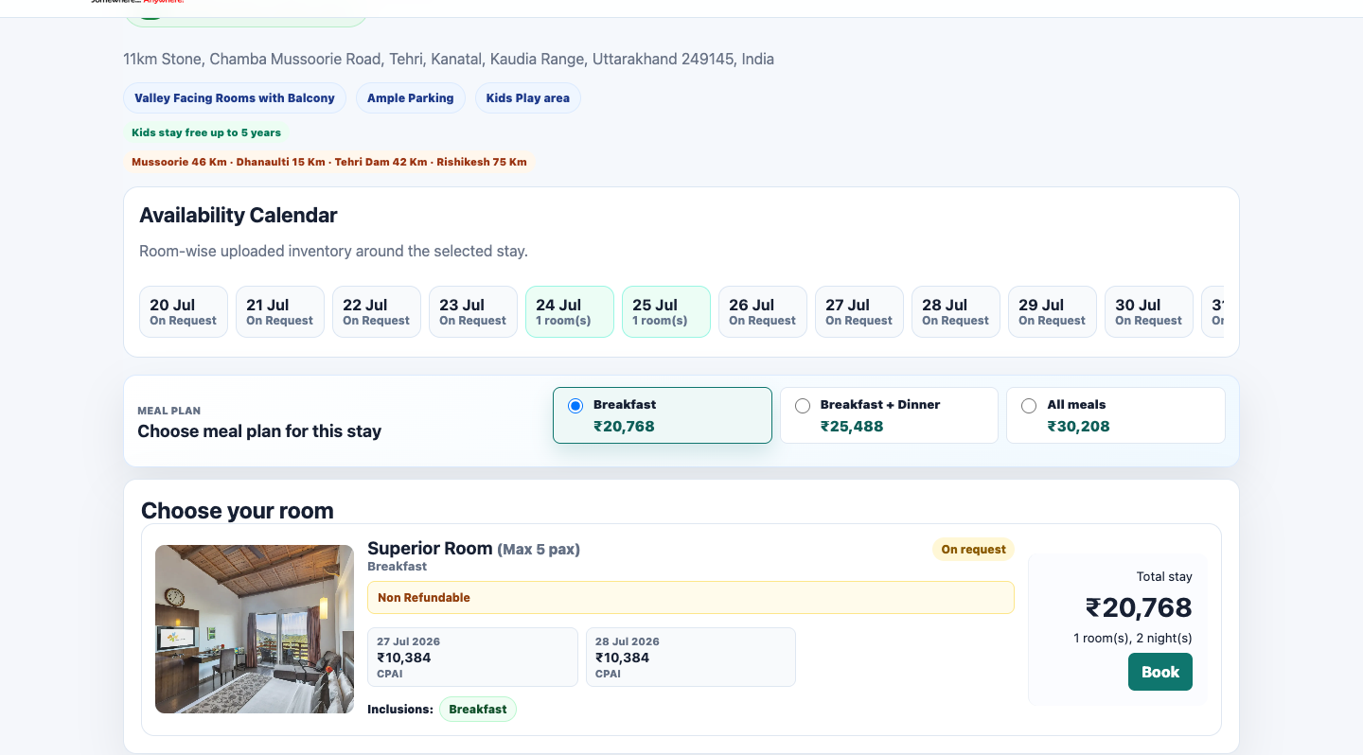
BOOKING FLOW
The booking page explains price, policy and guest details before request
This gives the buyer clarity and gives the hotel team a structured request instead of a loose WhatsApp message.
✓
Meal plan upgrade can update date-wise totals
✓
Guaranteed confirmation only when loaded inventory covers requested rooms
✓
On-request bookings stay trackable until supplier action
✓
Cancellation and payment deadlines are shown in simple language
Link by TA World
05

Slide 6
FOR STANDALONE HOTELS
A hotel gets an unlimited direct booking website with an optional addon of TA registrations
The hotel can run customer bookings first, and optionally enable travel-agent registration when it wants controlled B2B distribution.
Direct customer booking
Optional TA registration
Availability calendar
Voucher-ready flow
Open website for customers with room selection, guest details and booking request.
Enable agent registration as an add-on, then approve agents and apply hidden category pricing as per their potential
Show upcoming room inventory and on-request dates room-wise.
Booking, payment, cancellation and voucher actions stay in one place.
Optional add-on for single hotels
Travel Agent Registration: ₹7,999 → ₹4,999 + GST
Link by TA World
06

Slide 7
FOR CHAINS AND RESORT GROUPS
One brand can control many hotels from the same system
Chain teams can use a shared hotel master, property-wise inventory, chain-wide visibility and controlled rate distribution across multiple hotels.
Central hotel list
Property-wise rooms
Agent network
Reports and roles
Add/select which hotels appear on the frontend as per plan limits.
Each hotel keeps its own room categories, rates, images and policies.
Agents can register once under the chain and see only the sell rates intended for them.
Reservations, accounts and rate-loading teams can get restricted access.
Best fit: small chains, resort groups, hotel brands and management companies that want direct distribution without losing control.
Link by TA World
07

Slide 8
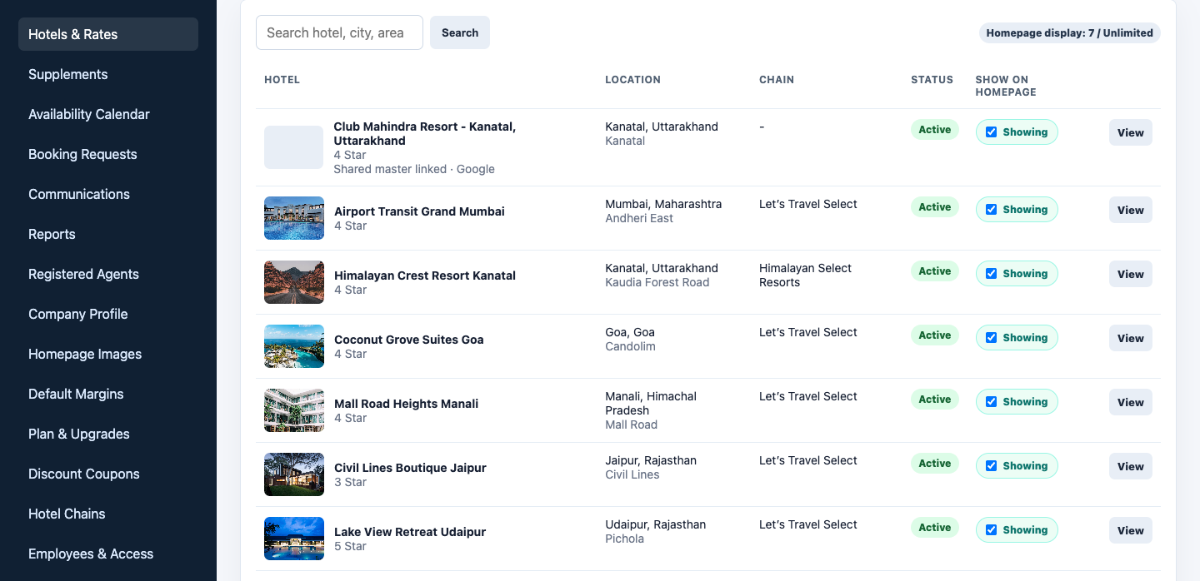
ADMIN CONTROL
Hotel teams control display, rates, inventory and operations
The backend is built around daily operational work: what is live, who can book, what rates apply, and what needs action.
Show on homepage
Plan-wise controls decide which hotels can be visible to customers.
Rate logic
Base net rates can become buyer-facing rates using margins and tax rules.
Operational menus
Bookings, agents, reports, communications, coupons, plans and employees live in one dashboard.
Link by TA World
08

Slide 9
RATE ENGINE
Rates are loaded the way hotel contracting actually works
Weekday/weekend rates, date ranges, special dates, taxes, supplements and inventory are separate controls so teams do not overwrite entire seasons for one change.
Base room rate
Date-wise net rate uploaded by supplier/hotel
Meals
Breakfast, dinner and all-meals upgrades can be calculated separately
Extra guest
Adult and child charges can be fixed or percentage based
Supplements
Peak-date additions such as Dussehra, Independence Day or long weekends
Inventory
Guaranteed confirmation only when loaded room count covers the request
Link by TA World
09

Slide 10
REVENUE TOOLS
Offers, coupons and marketing slots help hotels sell smarter
Link can show offers without hiding the rate logic, and it lets hotels promote the right room, date range or property.
Packages
Discount coupons
Homepage sliders
Book 3 nights, get last night complimentary; minimum-stay packages; room-only or booked-meal-plan benefits.
Hotel-wise, chain-wise, selected user/email, percentage cap or fixed amount discounts.
Promote a hotel, room, offer or marketing image on the website homepage.
Built for controlled promotion, not uncontrolled discounting.
Link by TA World
10

Slide 11
FITMENT
Single hotels and chains use the same core product differently
The base platform stays consistent; plan limits and optional controls decide how much distribution is opened.
Capability | Single Hotel | Chain / Resort Group
Direct customer booking | Yes | Yes
Travel agent registration | Optional add-on | Yes
Hotels on frontend | 1 selected hotel | Up to plan limit
Room categories and rates | Unlimited for selected hotel | Unlimited Property-wise
Availability calendar | Yes | Yes. Room-wise / property-wise
Employee access | Yes | Yes
Promotions and coupons | Yes | Hotel / chain / user specific
Link by TA World
11

Slide 12
PRICING
Simple plans cover one hotel, small chains and larger distribution
All prices are positioned for demo launch and include clear setup plus ongoing hosting/support options.
PLAN
RECOMMENDED
PLAN
PLAN
Starter
The Best
The Best+
Premium Managed
₹19,999
₹29,999
₹89,999
₹149,999
₹9,999
₹19,999
₹74,999
₹125,000
one-time setup + GST
one-time setup + GST
one-time setup + GST
one-time setup + GST
₹999/month
₹9,999/year
₹999/month
₹9,999/year
₹4,999/month
₹49,999/year
₹9,999/month
₹99,999/year
hosting/support + GST
hosting/support + GST
hosting/support + GST
hosting/support + GST
Single hotel direct booking or rate library. Optional TA registration add-on: ₹7,999 → ₹4,999 + GST.
Small chain / resort group up to 10 hotels, or agent portal selling up to 50 hotels.
Bigger chain / resort group up to 50 hotels or serious travel agent distribution.
Priority support, customisation, reports, voucher formats and heavier workflows.
Link by TA World
12

Slide 13
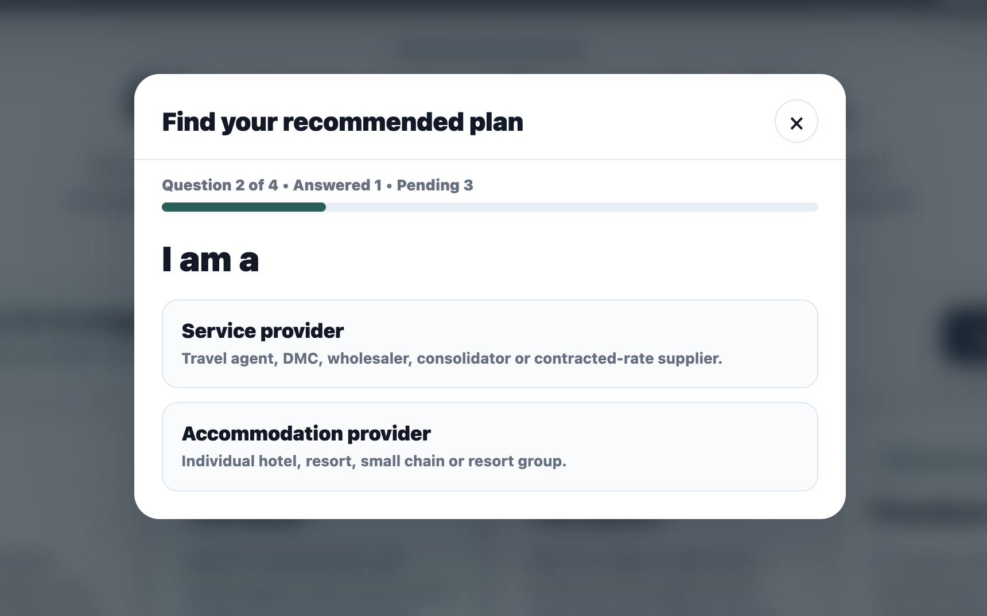
PLAN ADVISOR
Link can suggest the right plan automatically
A short guided flow asks hosting choice, business type and hotel count, then highlights the best plan without making visitors read every package.
1
Hosting managed by Link or self-hosted
2
Service provider or accommodation provider
3
Standalone, up to 10, or up to 50 hotels
4
Recommended plan highlighted automatically
Link by TA World
13

Slide 14
CONTROL AND TRUST
The system keeps sensitive business logic away from buyers
Agent categories, net rates, supplier-only contacts and admin controls remain private while buyers see only clean booking information.
Hidden rate categories
Employee access
CAT A/B/C are never exposed to travel agents.
Create users for reservations, accounts, rate loading and reports.
Notifications
Audit and reporting
Registration, booking, payment, voucher and cancellation alerts reduce missed actions.
Booking history, wallet movement, reports and operational actions stay traceable.
Link by TA World
14

Slide 15
SEE IT LIVE
Your hotel deserves more than WhatsApp bookings
Register on Link to get demo admin access, test the booking flow, and discuss the right setup for a standalone hotel, resort group or chain.
Website
Demo admin access
Contact
Vipul Tripathi
+91 99586 30101
https://link.taworld.co.in
https://link.taworld.co.in/supplier/register

